Slide 1
Platform Perils
Steven Palmer
Chao Ye
1

Slide 2
Outline
Introduction
Purpose
Scope
Background
Game Demonstration
Design
Overview of Features
Feature Showcase
OS Independent Installer
Building-Block Object Design
Level Script Parser
Testing
Conclusion
2

Slide 3
Purpose
To develop a “model” game for teaching purposes
The game should function as an example that students can build/modify/experiment with
3

Slide 4
Scope
Goal was to create a platformer game that utilized the Chipmunk2D physics engine
Short levels: restart from beginning on death
Focus on modular design that easily facilitates small changes
4

Slide 5
Background
A small game designed to be used as an example could act as a useful learning tool in a game design course
5

Slide 6
Demonstration
6

Slide 7
Design
MVC architecture used to separate into model, view, controller
Model: game stages, menu, objects, sounds, gpu data
Controller consists of a loop which passes user input to model, calls model update and render functions
View implicit in render calls – no modules
7

Slide 8
Design
A simplified representation of the game:
Model
Controller
Menu
Game Loop
input
update
render
or
Objects
Stage
8

Slide 9
Overview of Features
Product Features:
OS independent installer*
Modular design for easy modification
Custom shaders
Audio
Building block object implementation*
Level scripts*
9

Slide 10
Feature Showcase #1: OS Independent Installer
The ability to run on all platforms was an important requirement:
CS and SFWR ENG students use various operating systems
Windows, Mac, Linux predominantly
All libraries/code compatible with all three operating systems in theory
In practice, this wasn’t the case
10

Slide 11
Feature Showcase #1: OS Independent Installer
Challenge: Our implementation uses 5 external libraries
Chipmunk2D: physics engine
GLEW: graphics extension enablement
GLFW: window manager
OpenALSoft: audio library
FreeALUT: audio utility toolkit
Compiling each library on every platform out of the box was not successful, and the modifications/tweaks required to achieve successful compilation were not simple in most cases
Prebuilt libraries also problematic and don’t tend to work with different systems even on the same platform
11

Slide 12
Feature Showcase #1: OS Independent Installer
Solution: CMake (www.cmake.org)
CMake is a tool used to generate Makefiles
Uses custom scripts to handle platform/system dependent builds
Based on definitions in script, CMake will detect compiler, required libraries and other dependencies and generate a Makefile
12

Slide 13
Feature Showcase #1: OS Independent Installer
A CMake script was written for our game:
Checks if libraries are present – if so skips library compilation
If libraries not present, a Makefile for each missing library is built:
Each library came with a premade CMake scripts
Library creators claimed scripts to be OS-independent: this was not the case and many of the scripts required substantial edits
The scripts were also edited to reduce/eliminate unnecessary options, and to produce only static libraries (avoids executable dependence on dynamic libraries for slightly larger file size – good trade off!)
A Makefile for the game is built that invokes all of the library Makefiles then builds the game
13

Slide 14
Feature Showcase #1: OS Independent Installer
Demonstration
14

Slide 15
Feature Showcase #2: Building-Block Object Design
Object implementation was carried out using multiple levels of inheritance to produce a wide variety of objects with different behaviours that could all be processed in the same way via polymorphism
15

Slide 16
Feature Showcase #2: Building-Block Object Design
Obj
The Obj class is the top level class of the object class hierarchy
All objects inherit from this class
Contains general purpose fields that are required by all objects, mostly related to data for the GPU (meshes, textures, shaders)
Provides a common render function used by all object classes
16

Slide 17
Feature Showcase #2: Building-Block Object Design
Obj
PhysicsObject
The PhysicsObject class is the base class for all objects that are subject to physics calculations
Adds variables used by the Chipmunk2D physics engine to the Obj class
17

Slide 18
Feature Showcase #2: Building-Block Object Design
Obj
PhysicsObject
DynamicObject
DynamicObject: dynamic objects are objects on which both kinetic physics calculations as well as collision detection calculations are performed
The movement of these objects is entirely handled by the Chipmunk2D physics engine
18

Slide 19
Feature Showcase #2: Building-Block Object Design
Obj
PhysicsObject
DynamicObject
KinematicObject
KinematicObject: kinematic objects are objects on which only collision detection calculations are performed (no kinetics)
Collision detection handled by Chipmunk2D, all movement of objects handled through custom update function
19

Slide 20
Feature Showcase #2: Building-Block Object Design
Obj
PhysicsObject
DynamicObject
KinematicObject
StaticObject
StaticObject: static objects are objects on which only collision detection calculations are performed (no kinetics)
Collision detection handled by Chipmunk2D, no movement allowed
20

Slide 21
Feature Showcase #2: Building-Block Object Design
Obj
PhysicsObject
DynamicObject
KinematicObject
StaticObject
Surface
Surface: special case of static object
21

Slide 22
Feature Showcase #2: Building-Block Object Design
Obj
PhysicsObject
StandardObject
DynamicObject
KinematicObject
StaticObject
Surface
StandardObject: objects that do not participate in any physics/collision calculations
22

Slide 23
Feature Showcase #2: Building-Block Object Design
Obj
PhysicsObject
StandardObject
DynamicObject
KinematicObject
StaticObject
Surface
23

Slide 24
Feature Showcase #2: Building-Block Object Design
The result of this design is a very simple process for building levels
Simply need to add desired objects to a level and maintain a list of these objects
BEGIN FRAME
Call physics update function – performs physics calculation through timestep on all physics objects
Call update function on each kinetic object
Call render function on all objects
END FRAME
24

Slide 25
Feature Showcase #3: Level Script Parser
From our Lego-like implementation of objects, we end up with many different objects with different internal behaviours that appear the same externally
All objects have constructors of the form:
Object( float pos_x, float pos_y )
Some objects have a couple of additional constructor arguments
This allowed us to easily create a level script parser that loads levels at runtime
25

Slide 26
Feature Showcase #3: Level Script Parser
The level script format was designed to have a straight forward syntax such that levels could easily be created by anyone
Consists of section headings and definitions within those headings
26

Slide 27
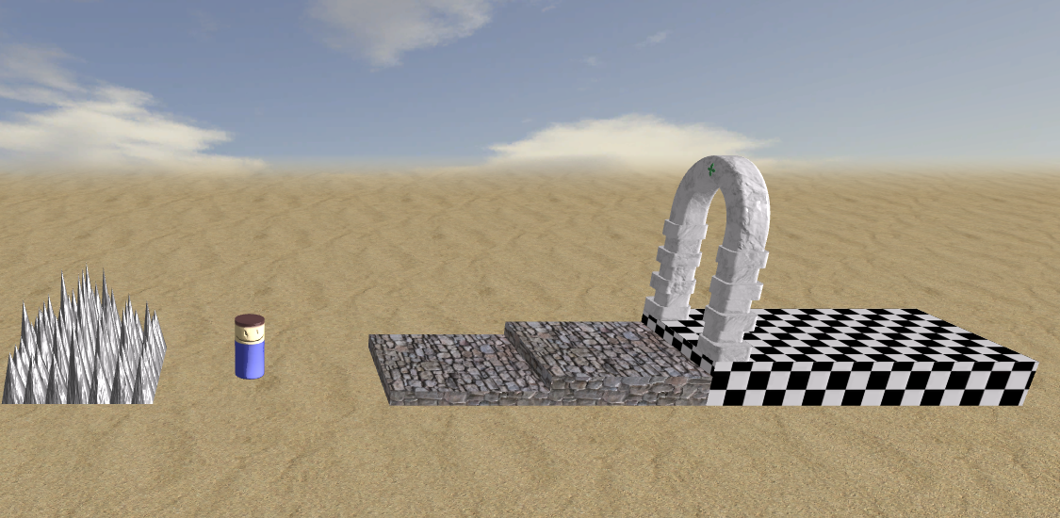
Feature Showcase #3: Level Scripts
**stage**
background=bluesky
setting=desert
startx=0
starty=0
**goal**
x=30 to 50, ytop=3, thickness=3
archpos=left
**platforms**
x=10 to 20, ytop=1
x=20 to 30, ytop=2, thickness=2
**hazards**
spikes, xright=-5, ybot=0
27

Slide 28
Feature Showcase #3: Level Script Parser
Demonstration
28

Slide 29
Product Testing
Automated unit testing:
A small unit testing suite was developed to ensure that physics calculations/collision detection works correctly
Manual testing:
Most of the testing was done manually
After any change to the code, the game was played to ensure everything worked correctly
29

Slide 30
Product Testing
Performance testing:
Performance testing was carried out using a high end and a low end test system
Framerate was used to measure performance
Framerate was measured while adding objects to a game level to assess the rate at which performance decreased
30

Slide 31
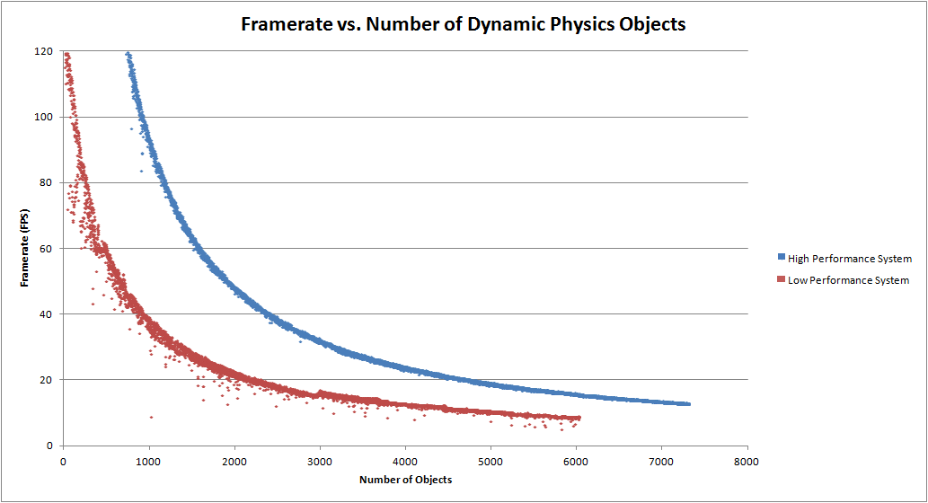
Product Testing
Performance testing:
Dynamic objects: most demanding (full physics)
Low performance system maintains 60 fps up to ~300 objects
This is more than sufficient
300
31

Slide 32
Conclusion
Platform Perils was developed for use as a teaching example
Modular code: make small changes and see result
Level scripts: easily modify levels/create new levels
32

